Slide 1


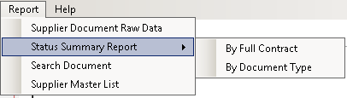
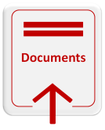
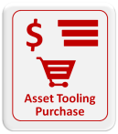
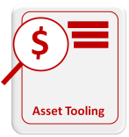
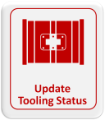
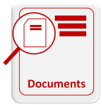
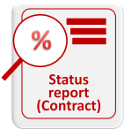
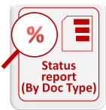
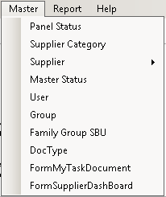
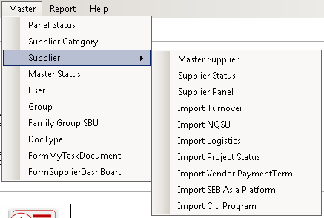
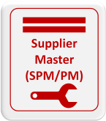
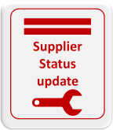
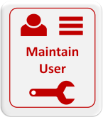
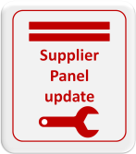
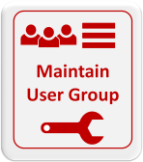

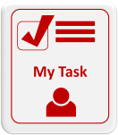
My Task moves to Supplier documents
Supplier Dashboard to be a new button

Slide 2

What do you want to do?
Overview/ Analysis
Tasks
My Tasks
Create Assets Purchase
Search existing Asset Purchase and update
Search Tooling and Update Status
Create Upload Documents
Pending document validation -Follow up expired documents
Receive tooling list, AEB, Invoice from supplier
Find existing Asset Purchase for review or add payment
Dispose, scrap (EOL), or transfer a tooling
Search/ Report
Supplier Information Dashboard
Search Documents
Download Contract status report
Download status report (by Doc type)
- An overview of supplier information
- Search supplier - how the supplier is performing.
Search and download documents
Download report by Full contract status
Download report by document type
Master
Update User/ Access profile
Update User Group for assigning supplier to user
Update SPM/PM supplier assignment and user replacement
Update supplier status
Update supplier Panel status

